Slide 1



Retail Store management System
LJ INSTITUTE OF ENGINEERING AND TECHNOLOGY

Slide 2
PREPARED BY :
NAME : GOEHL DHRUVI HIRENBHAI
ROLL NO : 17
ENROLLMENT NO : 23002170110044
BATCH : D1
BRANCH : CE
NAME : PATEL KHUSHI NARENDRAKUMAR
ROLL NO : 6
ENROLLMENT NO : 23002170110126
BATCH : D1
BRANCH : CE
NAME : MASRANI KASAK ATULBHAI
ROLL NO : 1
ENROLLMENT NO : 23002170110083
BATCH : D1
BRANCH : CE
NAME : PORNIKAR SAHIL HITESHBHAI
ROLL NO : 11
ENROLLMENT NO : 23002170110143
BATCH : D1
BRANCH : CE
NAME : MEVADA MANAN SHAILESHBHAI
ROLL NO : 24
ENROLLMENT NO : 23002170110089
BATCH : D1
BRANCH : CE

Slide 3

PROJECT OUTLINE
Introduction
Purpose Of the Project
Flow – Chart
ER Diagram
Use Case Diagram
Functionalities
Used Data Structures
Procedures
Merits & Demerits
Tools Used & References

Slide 4
introduction
The Retail Store Management System is a system designed for managing i.e. for ordering, arranging and selling good.
The Retail Store System is designed mainly for Grocery Items.
The System checks for the availability of goods in the store.
System updates product quantity during placing orders.

Slide 5
Purpose of Project
The purpose of this project is to design and implement a retail shop management system.
The system allows for:
Managing orders: Creating, viewing, and updating orders.
Managing products: Adding, viewing, and updating products.
Managing customers: Adding, viewing customer information.
Managing staff: Adding, viewing, and updating staff information.
Generating bills: Creating bills for orders.
Managing payments: Adding and viewing payments.
The project aims to provide a comprehensive solution for managing a retail shop's day-to-day operations,
improving efficiency, and reducing manual errors.

Slide 6
FLOW CHART
Start
Take User Choices
Manage Products
Manage Customers
Manage Payments
Manage Staff
Display Customer Purchase
Display Statistics
Manage Orders
Bill Generation
Display Product
Sales
Exit
Take User Choices
Stop
Take User Choices
Take User Choices

Slide 7
Manage Products
Add Products
View Products
View All Products
Delete Products
Update Products
Return
Take Product Details
Take Product Id
Display All Data
Take Product Id
Take Product Id
Take User Choices
Yes
Yes
Exists?
No
Yes
Exists?
No
Yes
Exists?
No
Valid?
No
Print success Message
Display Error
Display Data
Show Error
Display Data
Show Error
Take Details
Show Error
Display update Status

Slide 8
Manage Customers
Add Customer
View Customer
View All Customers
Return
Take Customer Details
Take Customer Id
Display All Data
Take User Choices
Yes
Valid?
No
Yes
Exists?
No
Print success Message
Display Error
Display Data
Show Error

Slide 9
Manage Orders
Place Orders
View Order
View All orders
Update Order
Return
Take Customer Id
Take Order Id
Display All Data
Take Order Id
Take User Choices
Exists?
Yes
No
Yes
Exists?
No
Yes
Exists?
No
Take Order Id
Display Error
Display Data
Show Error
Take Details
Show Error
Valid?
Save data & update product
Display Error
Display update Status

Slide 10
Manage Payments
Generate Bill
Take Order Id
Add Payment
View Payment
View All Payments
Return
Yes
Exists?
No
Take Order Id
Take Payment Id
Display All Data
Take User Choices
Display Bill
Display Error
Yes
Exists?
No
Yes
Exists?
No
Display bill paid
Yes
Bill paid?
No
Take Details
Display Error
Yes
Add?
No
Display Data
Show Error
Yes
No
Add Payment
Remind Customer
Success?
Save data & display message
Display Error
Take User Choices

Slide 11
Manage Staff
Add Staff
View Staff
View All Staffs
Update Staff
Return
Take Staff Id
Take Staff Id
Display All Data
Take Staff Id
Take User Choices
Yes
Exists?
No
Yes
Exists?
No
Yes
Exists?
No
Take Details
Display Error
Display Data
Show Error
Take Details
Yes
No
Show Error
Valid?
Save data
Display Error
Display update Status

Slide 12
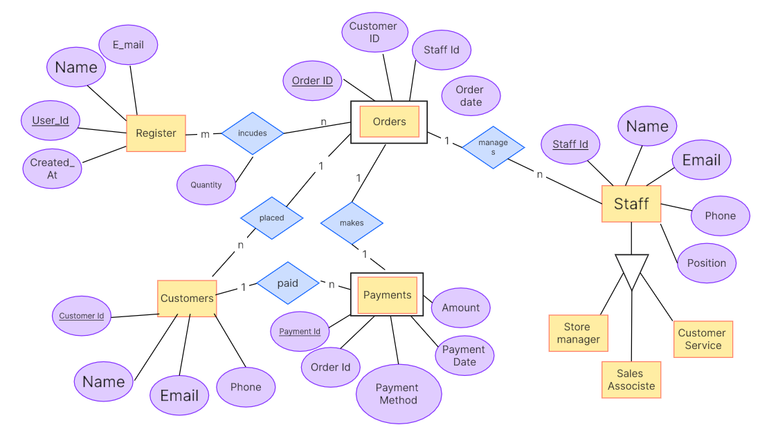
E R Diagram
Is-A

Slide 13
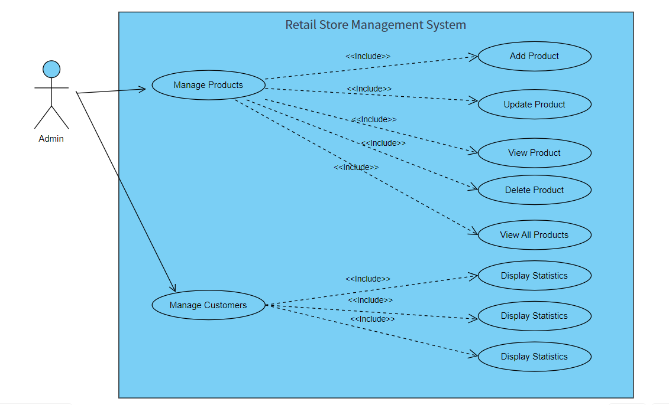
Use - Case diagram

Slide 14
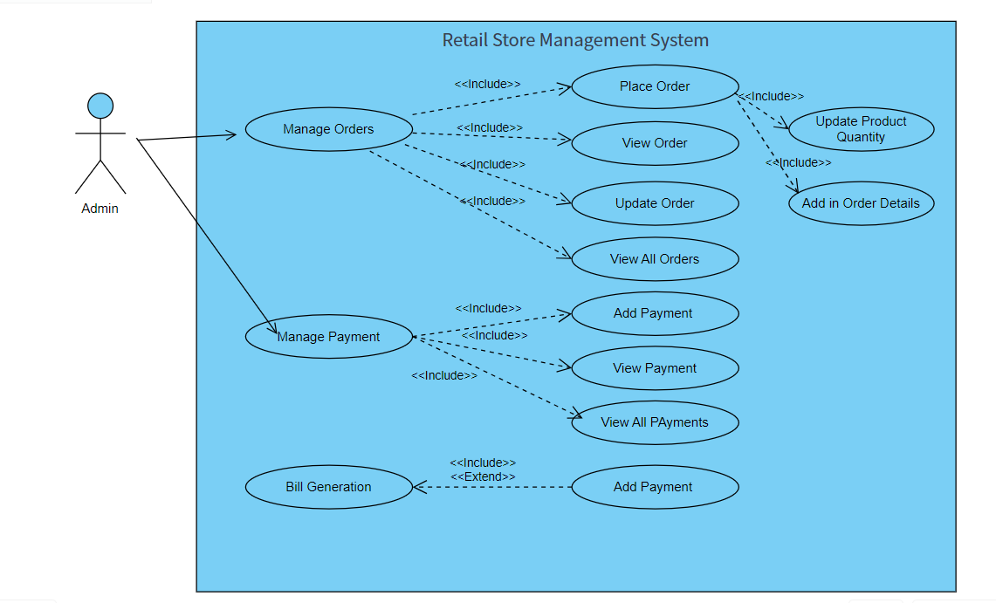
If not paid & admin selects to pay

Slide 15
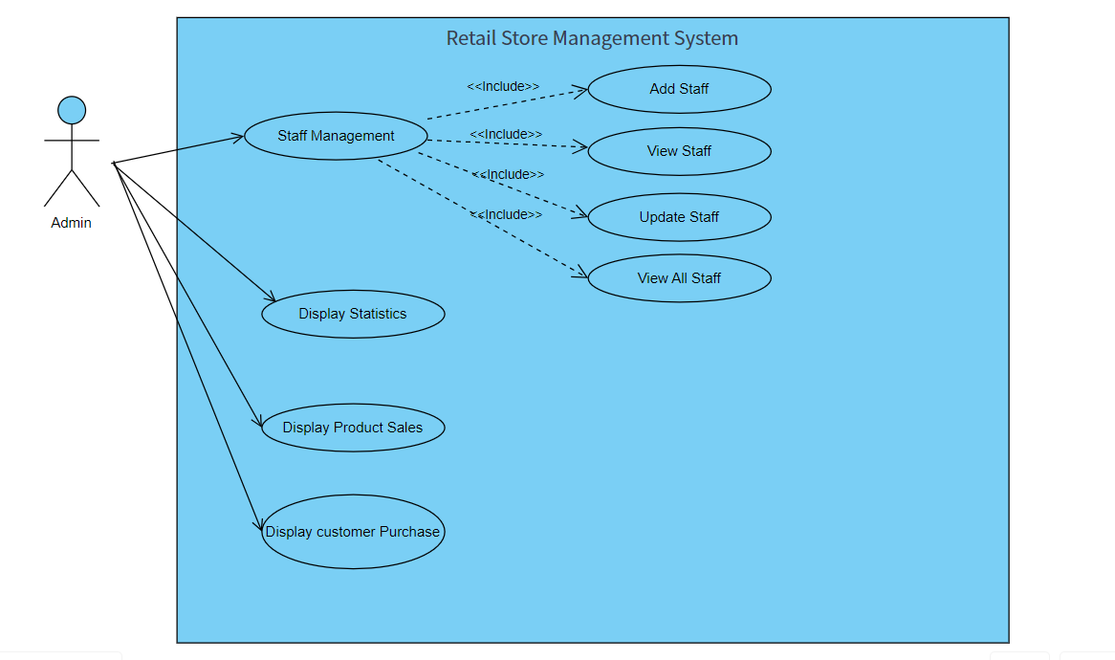

Slide 16
Functionalities
The provided Java code implements a Retail Store Management System with the following functionalities:
Product Management:
- Add products - View products - Delete products - View all products
- Update products
2. Customer Management:
- Add customers - View customers - View all customers
3. Order Management:
- Place orders - View orders - Update orders - View all orders

Slide 17
4. Payment Management:
- Add payments - View payments - View all payments
5. Staff Management:
- Add staff - View staff - Update staff - View all staff
6. Sales Analysis:
- Display product sales - Display customer purchases
7. Billing:
- Generate bills
8. Database Management:
- Create tables if not exist - Load products into BST (Binary Search Tree)
- Load sales analysis

Slide 18
java
Exception Handling: The code uses try-catch blocks to handle exceptions that may occur during database operations.
Object-Oriented Programming (OOP) Concepts: The code defines classes (e.g., Staff, Products)
User Input: The code uses Scanner to get user input.
String class methods
Product Quantities are Updated Whenever Product is Purchased
JDBC Connectivity
Bill Generation
Analysis of Product Sales And Customer Purchase Sales

Slide 19
Data structure
BST (Binary Search Tree) is used for:
Insertion of Products
Searching of Products
Deletion of Products
To calculate Total products and discontinued Products
Total Stock Value
Average Product Value
Use of Hash Map : For Product Sales Analysis
Use of Hash table : For Total Customer Purchase Analysis
Reasons To use BST :
Efficient search, Ordered storage, Scalability, Flexible querying.

Slide 20
database
Database Used To Orders, Payments, Products and Customers Record
MySQL database to retrieve Order Details, Payment details, customer details and Product details
Concepts Of relational database such as Inner Join is Used To retrive order details from tables OrderDetails and Orders.
Benefits : Data consistency, Reduced data redundancy, Improved data integrity.
Stored Procedure to Update Order details
Database Connection: The code establishes a connection to a MySQL database using the DriverManager class.

Slide 21
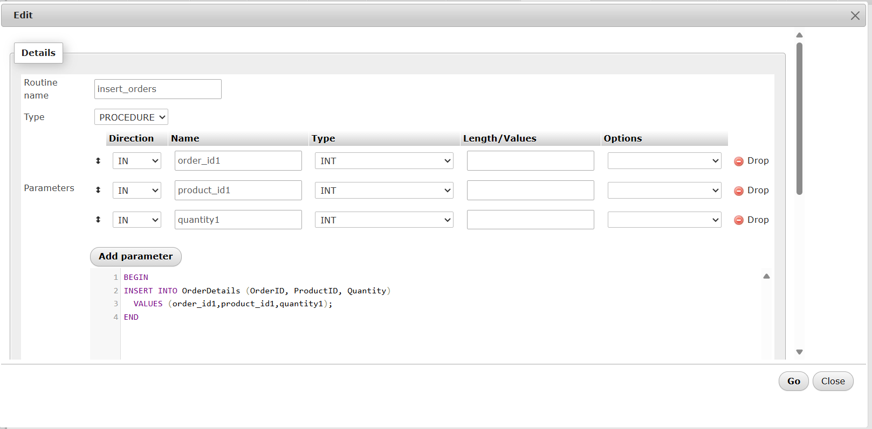
Procedure

Slide 22
Merits and demerits
Comprehensive functionality
User-friendly interface
Database integration
BST implementation
Modular design
Complexity
Limited error handling
Security concerns
Scalability limitations
Lack of data analytics

Slide 23

Tools Used:
Java : Visual Studio
Database : MySQL
References :
ChatGPT
https://www.slideshare.net/slideshow/11-retail-store-management/192308455
https://boardmix.com/app/editor/pVd-PcmXIadTjYSJSC4GBA

Slide 24
Thank you…

